Slide 1
Google Play Store Analysis With Apple Store Comparison
Thai Hoang

Slide 2
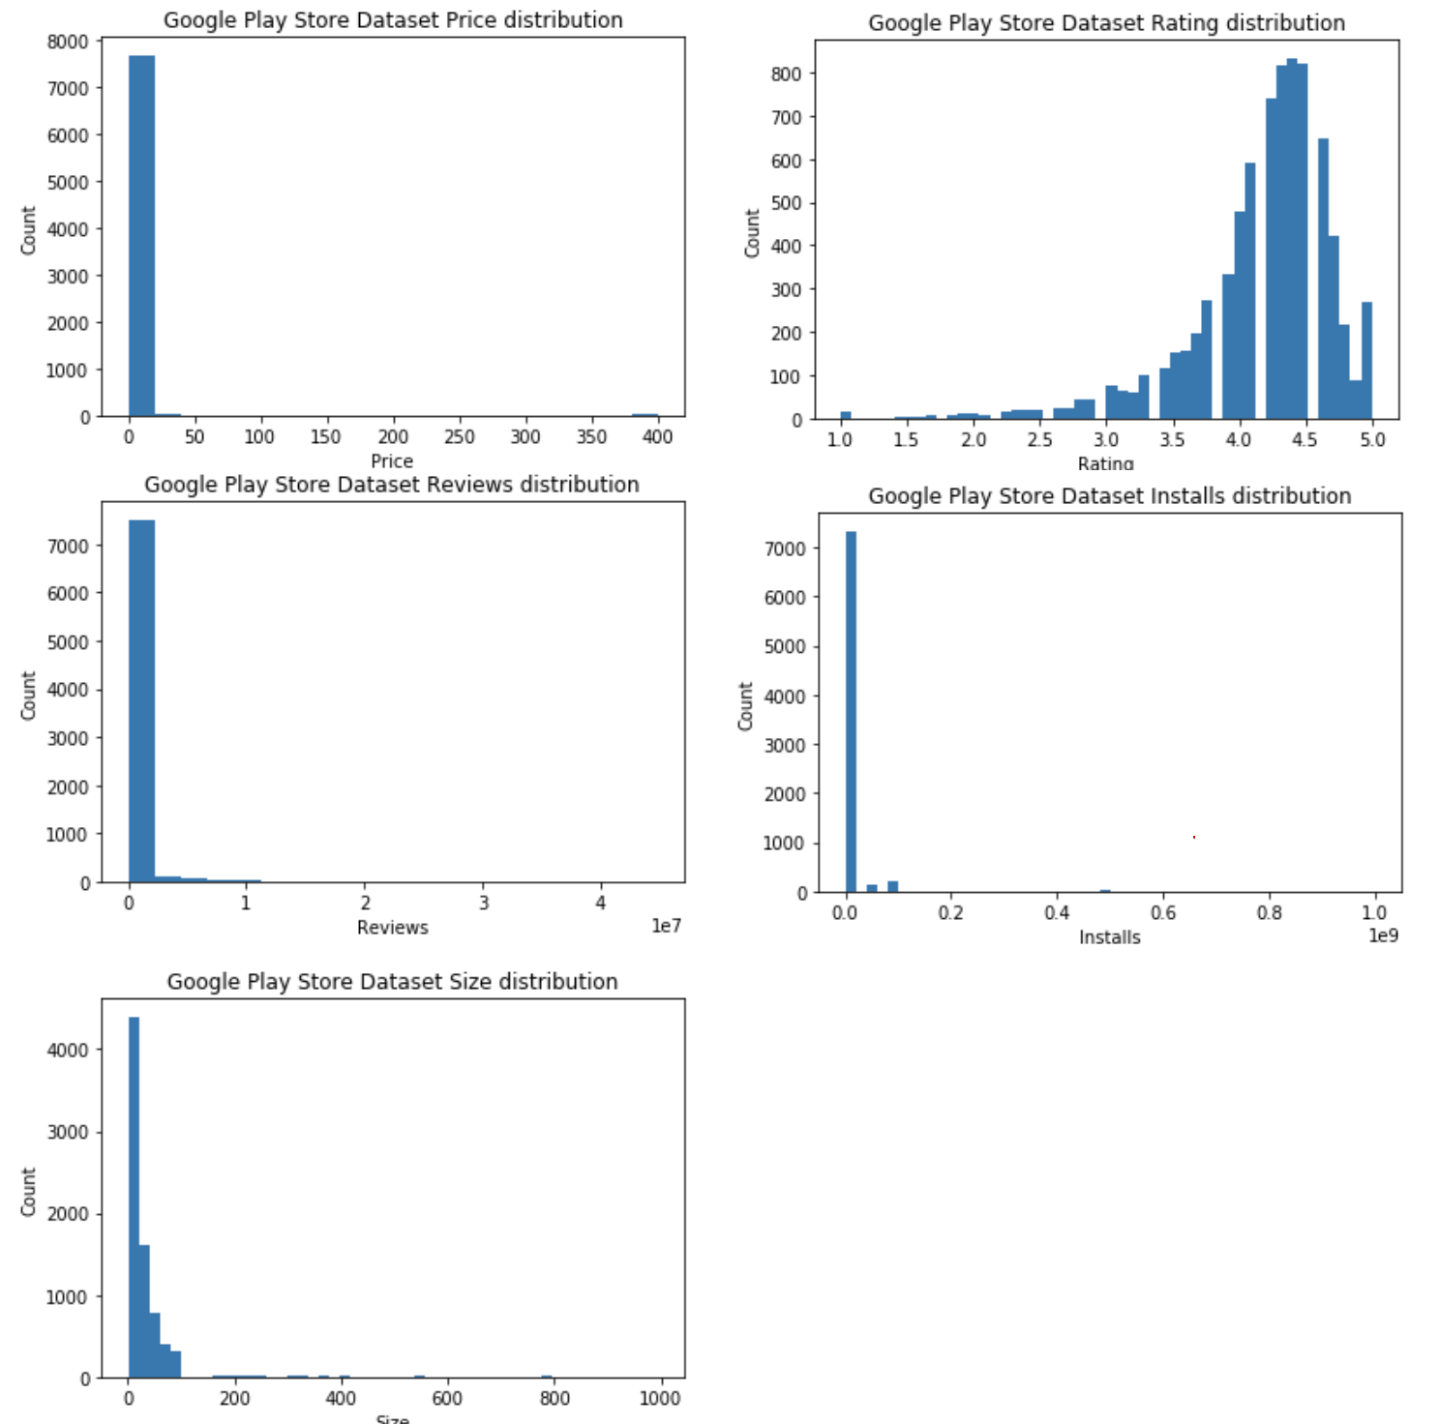
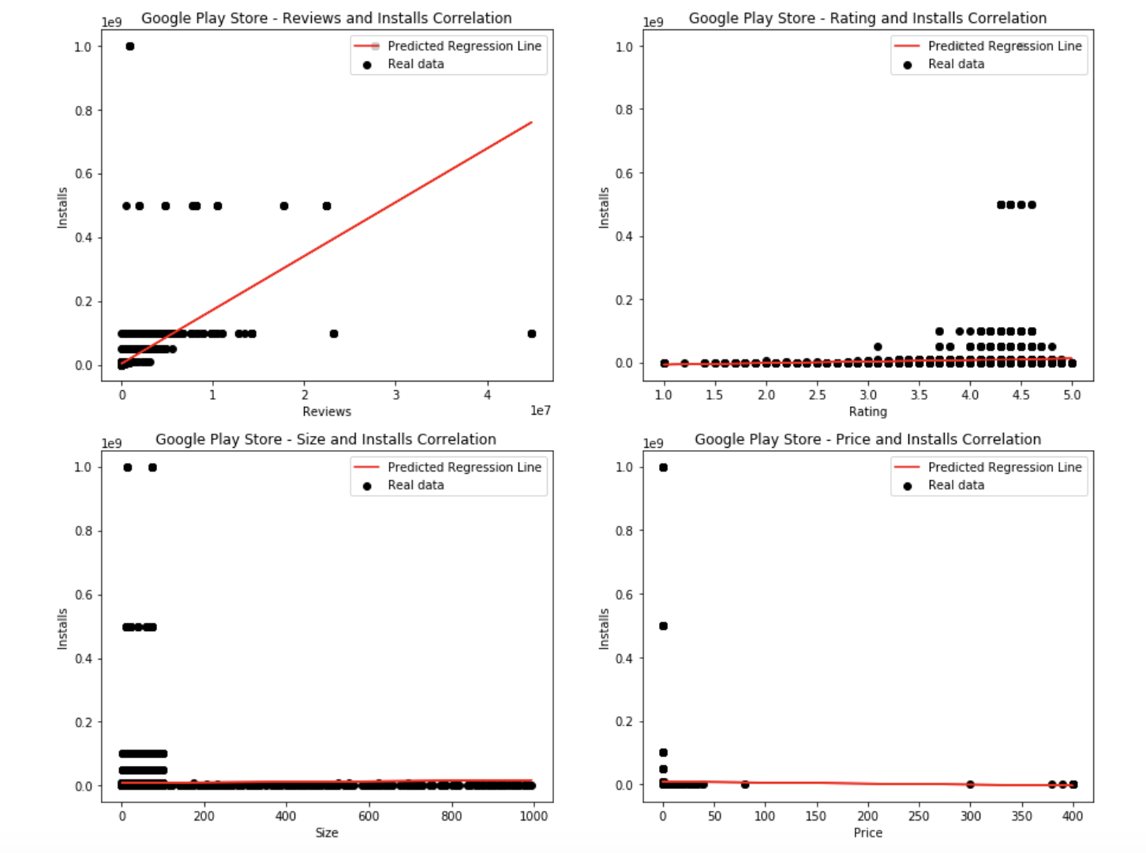
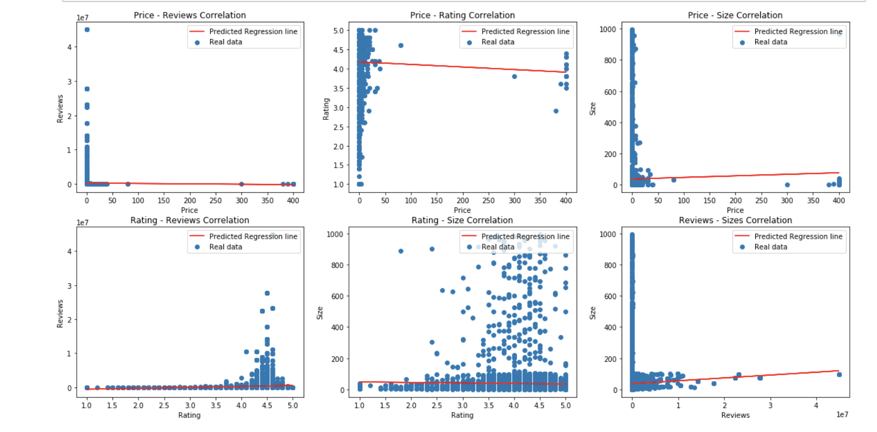
Research Question 1
Is there a strong linear correlation between the price of an application and the number of installs? Is there a strong linear correlation between rating and number of install? Is there a strong linear correlation between reviews and number of installs?

Slide 3
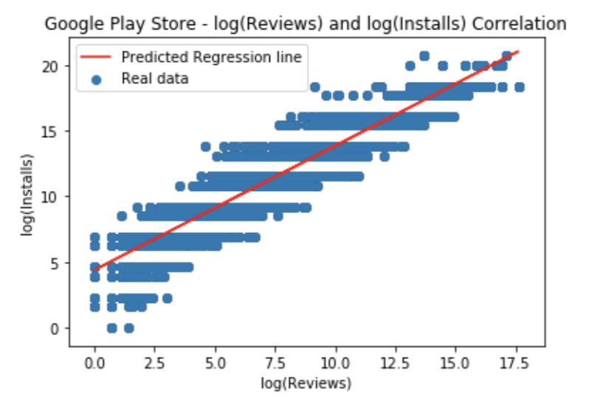
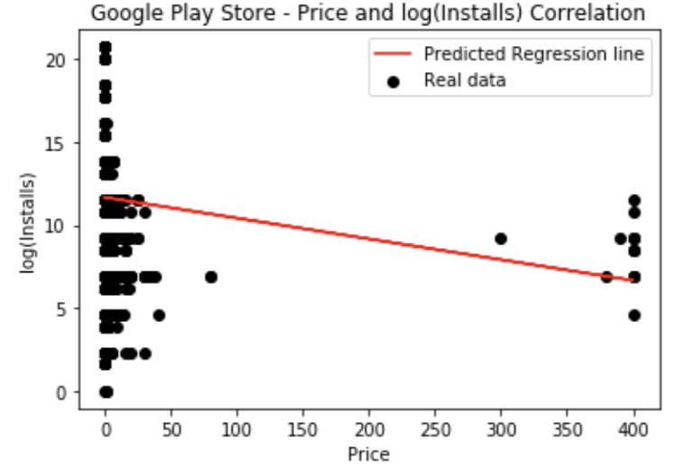
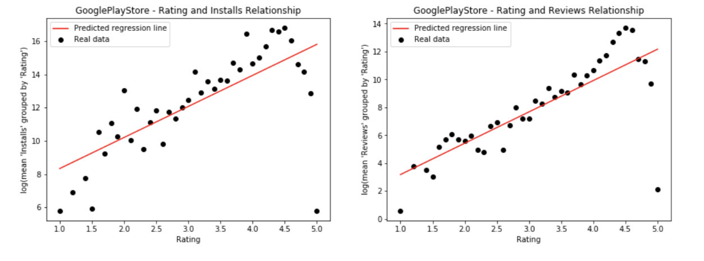
Research Question 2
If there is no strong correlation between these factors, are there any better relationships between these factors?

Slide 4
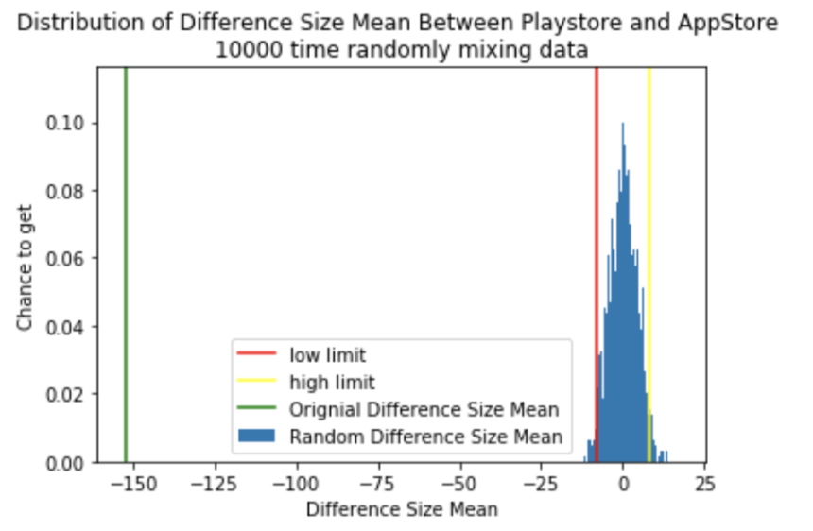
Research Question 3
Is the difference between the mean size of applications in Google Play Store dataset and size of applications in Appstore dataset is statistically significant?

Slide 5
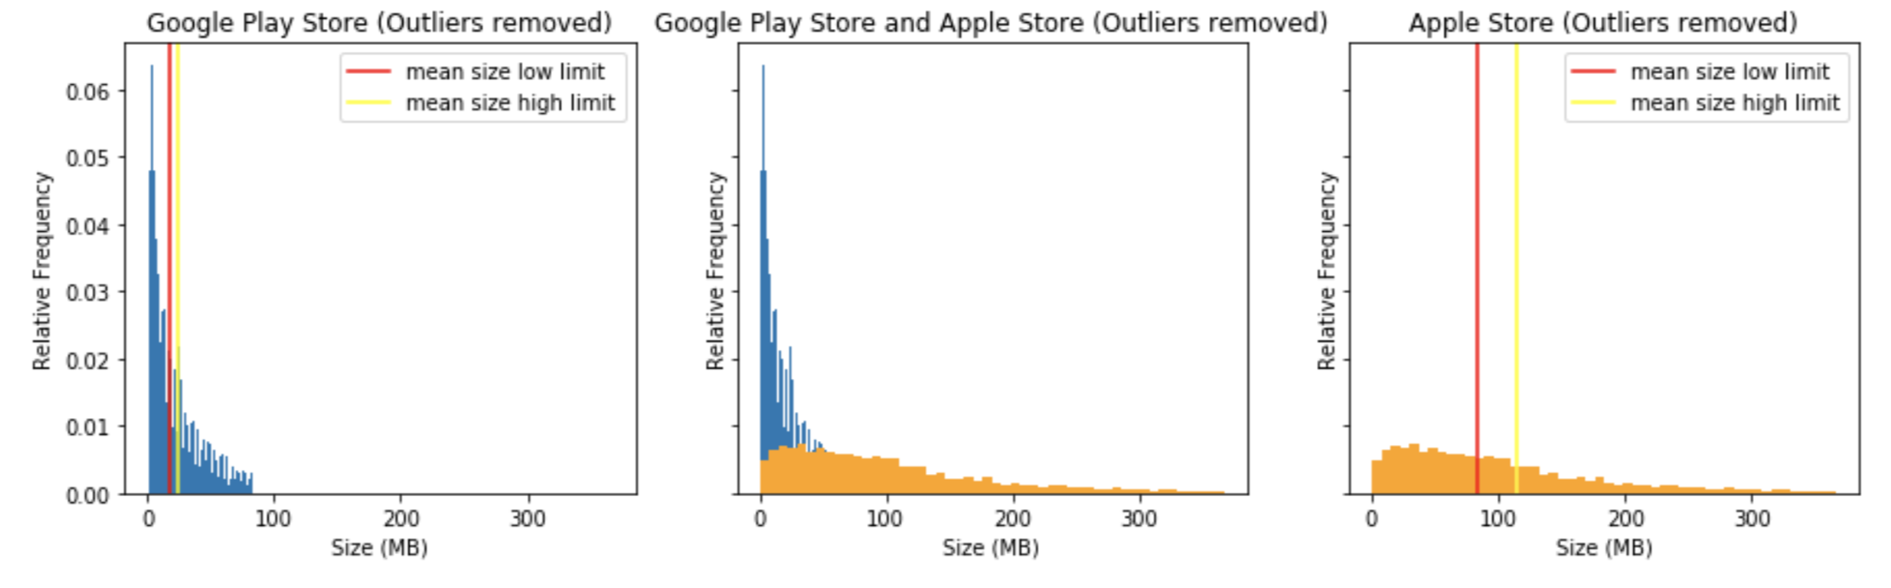
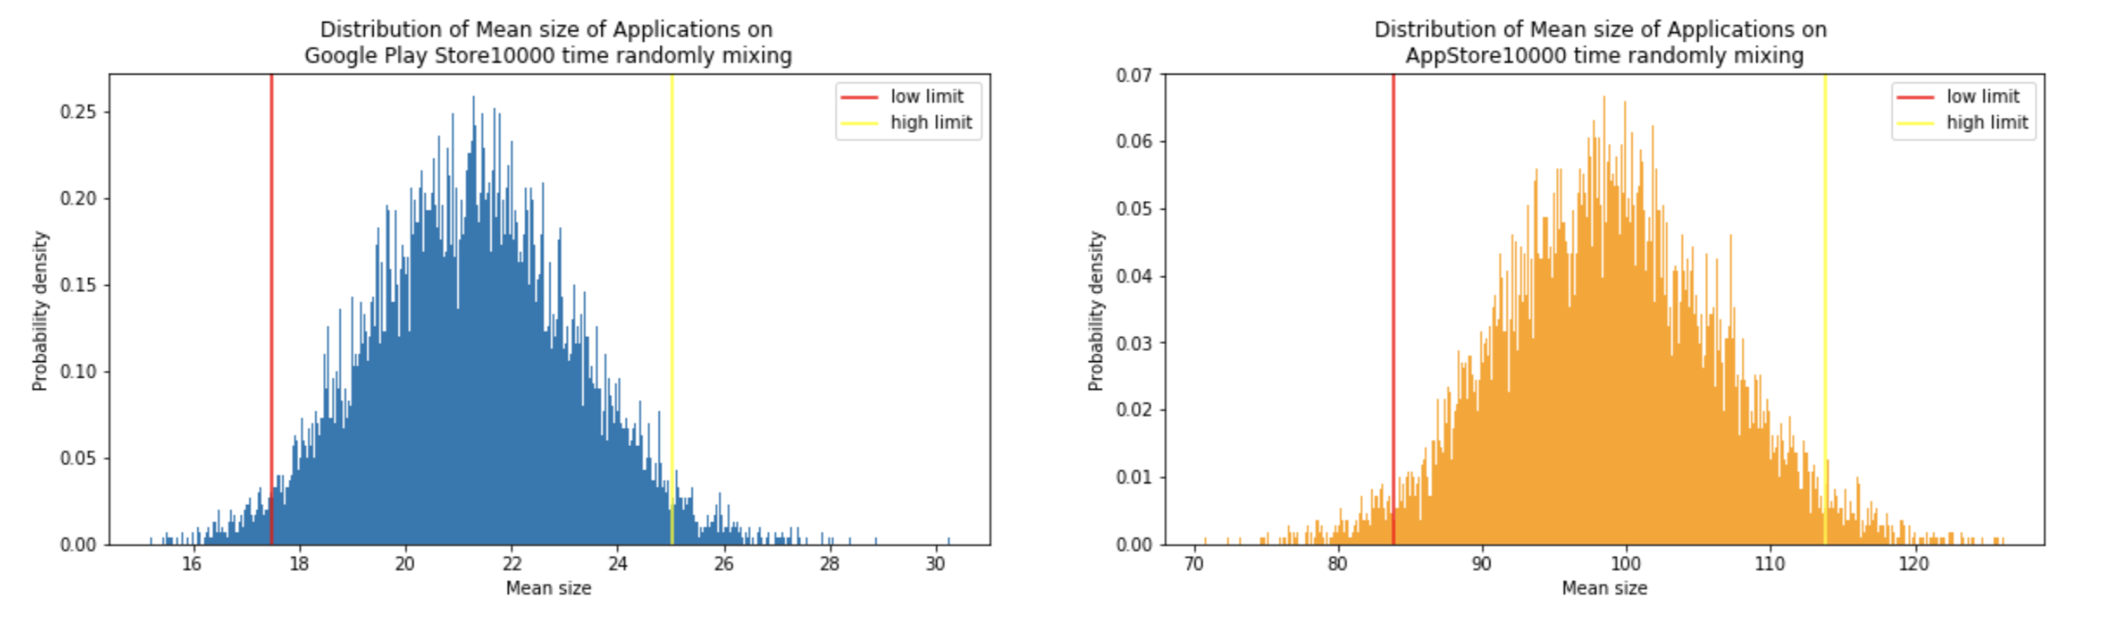
Research Question 4
What can we conclude about the mean size of applications on Google Play Store and Apple Store based on the dataset?

